Slide 1
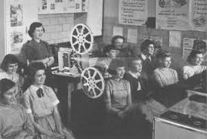
Ian Wall
Warsaw - May 2015

Slide 2
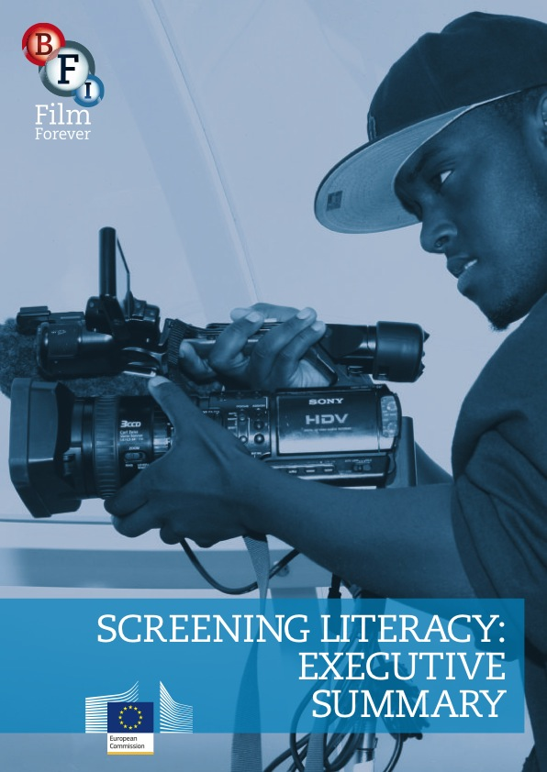
‘
‘the level of understanding of a film, the ability to be conscious and curious in the choice of films; the competence to critically watch a film and to analyse its content, cinematography and technical aspects; and the ability to manipulate its language and technical resources in creative moving image production’

Slide 3
RECOMMENDATION 1: draft a model of film education for Europe, including appreciation of film as an art form, critical understanding, access to national heritage, world cinema and popular film, and creative film-making skills.

Slide 4
PRINCIPLES
the importance of integrating critical and creative practices and processes with the widest possible participation in film culture
recognition of the specificities of film – as artform and text, with its own language, history, and aesthetics.
the entitlement of all children and young people to experience, learn about, and appreciate film through both the formal structures of schooling, and the informal environments of home, family, and society.

Slide 6
The Audience
Methodology
Content

Slide 7
Film sensibility

Slide 8
Film sensibility

Slide 9
Film sensibility

Slide 10
Film sensibility

Slide 11
Film sensibility

Slide 12
Film sensibility

Slide 13
Film sensibility

Slide 14
Film sensibility

